Slide 1
Java Best Practices
@rtoal
2013-06-12

Slide 2

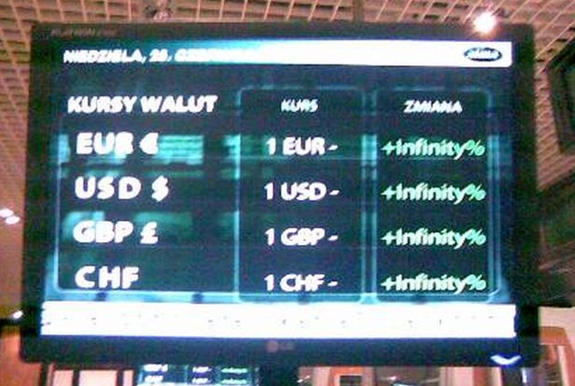
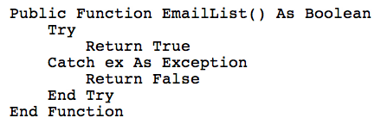
Why?
We professionals need to write code that is correct, reliable, maintainable, efficient, robust, resilient, readable, reusable, scalable, etc.

Slide 3

How do we learn best practices?
By understanding bad code
Okay, maybe not as bad as CodingHorror, SerialDate, and the thedailywtf (e.g.,this and this and this and this and this and this and this and this) ...
We mean innocent-looking code arising from misconceptions and inexperience

Slide 4

What will we look at?
Immutability
Collections
Guava
Exceptions
Polymorphism
Null
Exceptions
Concurrency
Formatting
Serialization
I/O
Comments
Validation
Logging
Generics
Security

Slide 5
What's wrong here?
public final class Task {
private final String name;
private final Date start;
public Task(final String name, final Date start) {
this.name = name;
this.start = start;
}
public String getName() {return name;}
public Date getStart() {return start;}
}
java.util.
Date is mutable

Slide 6
Immutability
Immutable objects
are thread-safe
can be shared (cached)
can't be trashed by someone else's code
make great hashtable keys!
lead to simpler code (e.g. no need to "undo" anything when backtracking)
BEST PRACTICE
Favor immutable objects, using mutable objects only when absolutely necessary

Slide 7
Defensive Copying
public final class Task {
private final String name;
private final Date start;
public Task(final String name, final Date start) {
this.name = name;
this.start = new Date(start.getTime());
}
public String getName() {return name;}
public Date getStart() {return new Date(start.getTime());}
}
COPY
COPY
BEST PRACTICE
Use defensive copying if your immutable class contains mutable fields

Slide 8
Maybe you can avoid mutable fields
Date is mutable; use Joda-Time instead
SimpleDateFormat is mutable; use Joda-Time instead
Standard Java collections are mutable (even the "unmodifiable" ones); use the immutable Guava collections instead
BEST PRACTICE
Use Joda-Time and Guava

Slide 9

Speaking of Guava
Why Guava?
It's already written (reinventing takes too long and you make mistakes)
It's extensively tested
It's optimized
It's constantly being evolved and improved
BEST PRACTICE
Know and use the libraries — especially Guava

Slide 10
Guava awesomes
Map<String, Map<Integer, Budget>> m = Maps.newHashMap();
ImmutableSet<Integer> s = ImmutableSet.of(1, 3, 9, 6);
Collection<?> b = filter(a, notNull());
Multimap<String, Integer> scores = HashMultimap.create();
scores.put("Alice", 75);
scores.put("Alice", 22);
scores.put("Alice", 99);
System.out.println(Collections.max(scores.get("Alice")));
Splitter.on(',').trimResults().omitEmptyStrings().split("63,22,, 9");

Slide 11

More Guava wins
@Override
public int compareTo(final Dog d) {
return ComparisonChain.start().compare(
age, d.age).compare(breed, d.breed).result();
}
checkArgument(count > 0, "must be positive: %s", count);
Precondition
BEST PRACTICE
Use preconditions (to remove if-statements from your code)

Slide 12
Speaking of Joda-Time
Check it out
Know the concepts!
Instant - DateTime, DateMidnight, MutableDateTime
Partial - LocalDateTime, LocalDate, LocalTime
Duration (a number of millis)
Interval (two instants)
Period (in human-understandable terms, e.g, days/weeks)
Chronology

Slide 13
What's wrong here?
@Controller
public class DepositController {
private int accountId;
private BigDecimal depositAmount;
@POST @RequestMapping("/deposit/{id}")
public Response handleDeposit(@Param("id") String id,
String amount) {
this.accountId = validateId(id);
this.depositAmount = validateAmount(amount);
service.makeDeposit(accountId, depositAmount);

Slide 14
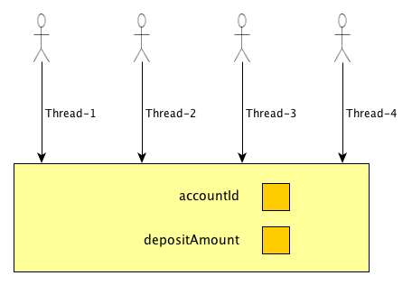
Grrrrr — Singletons!
Each request is running on a separate thread most likely

Slide 15
The fix is obvious, isn't it?
public class DepositController {
@POST @RequestMapping("/deposit/{id}")
public Response handleDeposit(@Param("id") String id,
String amount) {
int accountId = validateId(id);
BigDecimal deposit = validateAmount(amount);
service.makeDeposit(accountId, deposit);
BEST PRACTICE
Don't put state in shared singletons like controllers, services, and daos

Slide 16
What's wrong here?
public class FeedConfig {
public FeedConfig(String feedFileId,
String feedId, String name, String url,
String compressionType,
ConversionType conversionType,
ProviderType providerType,
boolean createsNewListing) {
. . .
}

Slide 17

Too Many Parameters!
When you call a constructor (or any method, for that matter) with a zillion arguments, what do they all mean?
In dynamic languages, we pass hashes (usually)
Can we do that in Java?
What is wrong with you?

Slide 18
Fluent Builders
config = new FeedFileConfigBuilder()
.feedFileId("483")
.feedId("22")
.name("iusa-CA")
.url("ftp://example.com/iusa/ca/feed")
.compressionType("zip")
.conversionType(Conversion.CUSTOM)
.createsNewListing(false)
.build();
The builder is mutable but the object that is built is immutable.
BEST PRACTICE
Consider builders for classes with many properties

Slide 19
What's wrong here?
start = System.currentTimeMillis();
price = computePrice();
finish = System.currentTimeMillis();
logger.debug("Computed price of $"
+ new DecimalFormat("#0.00").format(price)
+ " in " + (finish - start) + " milliseconds");
Timing clutters the code .... it's an aspect
Should use a currency formatter ( i18n )
Is that the only formatter we'll need?
And what if we are not in debug mode?

Slide 20
Making Logging Efficient
if (logger.isDebugEnabled()) {
logger.debug(. . .);
}
if (logger.isInfoEnabled()) {
logger.info(. . .);
}
BEST PRACTICE
Wrap logging calls for complex messages in isXXXEnabled() conditions

Slide 21
Logging Levels
FATAL — app not expected to recover
ERROR — error that app might recover from
WARN — take notice, potentially harmful
INFO — coarse-grained app progress
DEBUG — to help you debug
TRACE — super-fine-grained progress
BEST PRACTICE
Know and use the proper logging levels

Slide 22

What's wrong here?
// tagging data case 2: tags field is not null and primaryTagId is not null, but
// primary tag is not included in the tags field, append primaryTagId tagIds = (StringUtils.isNotBlank(tagIds)&&StringUtils.isNotBlank(primaryTagId)
? (tagIds.contains(primaryTagId)
? tagIds
: new StringBuilder(tagIds).append(",").append(primaryTagId).toString())
: tagIds);

Slide 23

What's wrong here?
// *************************************** //
// ***** INSTANCE METHODS ***** //
// *************************************** //
/**
* Returns the count.
* @return the count
*/
public int getCount(/* no args */) {
// NOTE: count is a field
return count; // return the count
} // end of instance method getCount
You KNOW how I feel about comments!

Slide 24
What's wrong here?
public void registerItem(Item item) {
if (item != null) {
Registry registry = store.getRegistry();
if (registry != null) {
Item existing = registry.getItem(item.getId());
if (existing.getBillingPeriod().hasRetailOwner()) {
existing.register(item);
}
}
}
}
OH! SOME MISSING NULL CHECKS? I DIDN'T SEE THEM.
THINK HARDER
From Robert C Martin's Clean Code book (page 110).

Slide 25
Don't return null
Actually, there are too many null checks, not too few
Returning null as a normal case forces users to clutter their code
BEST PRACTICE
Don't return null! For collections, return an empty collection. For plain objects, throw an exception or return a special case object.

Slide 26
What's wrong here?
public void writeToFile(String filename, List<String> lines) {
try {
Writer writer = new PrintWriter(new FileWriter(filename));
for (String line : lines) {
writer.append(line);
writer.append(System.getProperty("line.separator"));
}
} catch (IOException e) {
logger.error("FAILED WRITING TO: " + filename + ", RESUMING");
}
}
OH! - Not closing!! - Won't flush!!!!

Slide 27
Improved, but still wrong-ish
public void writeToFile(String filename, List<String> lines) {
Writer writer = null;
try {
writer = new PrintWriter(new FileWriter(filename));
for (String line : lines) {
writer.append(line);
writer.append(System.getProperty("line.separator"));
}
} catch (IOException e) {
logger.error("FAILED WRITING TO: " + filename + ", RESUMING");
} finally {
if (writer != null) {
try {
writer.close();
} catch (IOException e) {
logger.error("FAILEDTO CLOSE: " + filename + ", RESUMING");
}
}
}
}
The code duplication is bad, too
You're kidding me? Added 8 lines just to close the file?!?!?

Slide 28
Getting Better
public void writeToFile(String filename, List<String> lines) {
PrintWriter writer = null;
try {
writer = new PrintWriter(new FileWriter(filename));
for (String line : lines) {
writer.println(line);
}
} catch (IOException e) {
logger.error("FAILED WRITING TO: " + filename + ", RESUMING");
} finally {
if (writer != null) {
writer.close();
}
}
}
PrintWriter.close() eats the IOException, if any, saving a few lines....

Slide 29
A Little Bit Better
public void writeToFile(String filename, List<String> lines) {
PrintWriter writer = null;
try {
writer = new PrintWriter(new FileWriter(filename));
for (String line : lines) {
writer.println(line);
}
} catch (IOException e) {
logger.error("FAILED WRITING TO: " + filename + ", RESUMING");
} finally {
IOUtils.closeQuietly(writer);
}
}
IOUtils.closeQuitely from Apache Commons is null-safe, saving a couple more lines....

Slide 30
Solutions
Guava has the Files class with utility methods that guarantee the file will be closed no matter what. Check it out for homework....
Or just use Java 7
try (PrintWriter output = new PrintWriter(new FileWriter(filename))) {
for (String line: lines) {
output.println(line);
}
} catch (IOException e) {
logger.error("FAILED WRITING TO: " + filename + ", RESUMING");
}

Slide 31
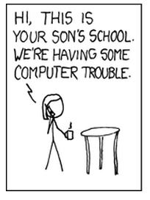
What's wrong here?
String first = servlet.getRequest().getParam("first");
...
template.update("insert into students values ("
+ " ss.nextval,'" + last + "','" + first + "')");
Parameter processing and database access are jammed together in the same file, showing a complete lack of architectural sense.
Things look better when the SQL is moved out of the query call.
Is that it? Wait, there's something else, I think? Something seems wrong here....

Slide 32
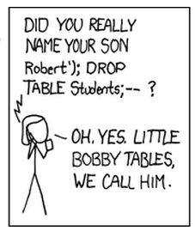
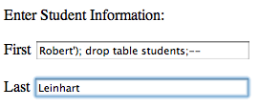
SQL Injection
insert into students values (ss.nextval, 'Leinhart', 'Robert'); drop table students;--')

Slide 33
JDBC Parameters
Parameters prevent injection attacks and help with the efficiency gain in prepared statements
template.update("insert into students values ("
+ " ss.nextval, ?, ?)", last, first);
template.update("insert into students values ("
+ " ss.nextval, :last, :first)", map);
BEST PRACTICE
Always use SQL parameters

Slide 34
What's wrong here?
(Job = standalone application)
public class SuperImportantJob {
public static void main(String[] args) {
try {
doSomething();
doTheNextThing();
doTheLastThing();
} catch (Exception e) {
logger.fatal("Job Failed", e);
}
}
}
HINT: THE CONFIGURATION MANAGEMENT TEAM IS NOT HAPPY WITH YOU TODAY

Slide 35
You are not the center of the universe
public static void main(String[] args) {
try {
....
} catch (Exception e) {
logger.fatal("Job Failed", e);
System.exit(1);
}
}
Your app got called by a bash script or was launched by a Jenkins job. And someone else's job is gonna follow yours.
BEST PRACTICE
Return non-zero status codes from failing jobs (via System.exit or exception)

Slide 36
And what is wrong with this?
new Thread()
BEST PRACTICE
Don't create your own threads; use an executor service as it will do most of the thread pool management for you

Slide 37
Serialization
Some serialization questions for homework...
What is the serialVersionUID?
What happens if you don't explicitly specify a value for this field?
Why is it a best practice to always specify a value for this field?
What happens if you do specify a value, then change your class, but do not change it?
What does Josh Bloch say about all this?

Slide 38
A few more practices
Write DRY code and DAMP tests
Put calls in the proper place, e.g., don't formulate response JSON or HTML in a dao
Avoid magic numbers (except maybe 0, 1); use private static final (constants)
Superclasses should not know about their subclasses
Consider domain-specific exceptions over built-in general purpose exceptions
Avoid double negatives, e.g., if (!notFound())
Use BigDecimal, not double, for money

Slide 39
But wait, there are more!
Comment only when you must
Get rid of obsolete, redundant, inappropriate, rambling, crappily written comments
DELETE COMMENTED OUT CODE
Follow Uncle Bob's naming guidelines
No Hungarian Notation, please
Avoid bad names: tmp, dummy, flag
Don't write functions that expect booleans or nulls or things to switch on
Avoid "out parameters", return things instead
Prefer the single-return style

Slide 40
Ooooh! Yet more Java advice
Don't make something static when there is an obvious object it can operate on
Override hashCode if you override equals
Don't make a new java.util.Random every time
Put configurable data in their own classes or resources
Don't put constants in interfaces just so you can implement the interface to avoid qualification; use import static instead
Make constructors private when you should

Slide 41

Aaah the best practice aliens have control of my brain
Use enums, not lame int constants
Inner classes for observers or row mappers often look nicer as nested static classes (and are ever so slightly more efficient)
Don't do string concatenation in a loop
Use the AtomicXXX classes
Make sure .equals() checks for null
Never call .equals(null)

Slide 42
Clean your code with Java 7
Strings in switch statement
Binary integral literals
Underscores in numeric literals
Multi-catch and more precise rethrow
Generic instance creation type inference
Try-with-resources statement
Simplified varargs method invocation
http://www.javacodegeeks.com/2011/11/java-7-feature-overview.html

Slide 43
More Java 7 Goodness
ThreadLocalRandom
ForkJoinPool and ForkJoinTask
Phaser
NIO 2.0
Zip File System Provider
Elliptic Curve Cryptography
Disabling of weak cryptographic algorithms
Sockets Direct Protocol

Slide 44



Where can you find more info?
http://findbugs.sourceforge.net/bugDescriptions.html
http://checkstyle.sourceforge.net/availablechecks.html
http://pmd.sourceforge.net/pmd-5.0.4/rules/index.html

Slide 45
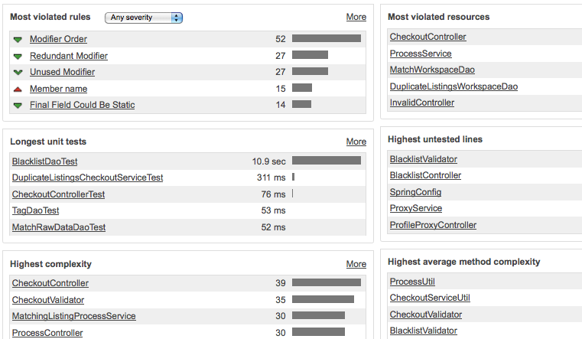
Sonar
Sonar can take output from PMD, Checkstyle, etc. and present it to you in a useful way.

Slide 46
Homework (Hey why not?)
Skim the list of FindBugs Bug Descriptions
Find an item on JavaPractices.com that you disagree with
Read an article on serialization
Run FindBugs, using the highest possible analysis settings, on a Java Project that you worked on
Refactor some existing code using Guava and Java 7

Slide 47
That's it
Questions or comments?

